Slide 1
X Share
- The Android App to Share Video
Group I
Yang Xu (0447755)
Zhili Guo(0398903)
NYU.Poly

Slide 2
Outline
Basic Idea
Project Description
Functionalities
Implementation
Demo
Future Work

Slide 3

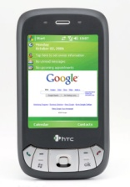
Basic Idea
Amazon
Cloud Servers
Avishkar
Watch
Video
Record Video
Sambit
Zhili
Yang

Slide 4

Project Description
Android Platform Based
Android SDK + Android Emulator
Amazon Cloud Service Based
Use AWS SDK for Android to do development
Many services available in AWS SDK for compute are not supported in AWS SDK for Android any more (e.g. Amazon RDS). And some features are totally different (e.g. Authentication).
The services that we used:
Amazon S3 to store uploaded video contents
Amazon CloudFront to realize CDN cache for video contents
Amazon SimpleDB to store user-relationship and video contents related information
Amazon Security Token Service to request temporary, limited-privilege credentials for AWS Identity and Access Management (IAM) users or for users that you authenticate (federated users)

Slide 5
Functionalities
User Verification
Username and password will be required for verification. Verified users will be given a temporal Amazon AWS credential for further operation.
Add User
New user can be added into the system. Username and password is required.
Add Friend
A user can add friend relationship with other users. Multiple friends can be added for one time.
Create video news
A user can create video news. For the video news that he created, he can set it to one of three access options: broadcast it to everyone, broadcast it to his friends, keep it to himself. The video content will be stored in Amazon S3 bucket and be distributed using Amazon Cloudfront service (CDN).
View video news
Every time a user logs into the system, he can choose to view video news. The user will first get a list of the news and then he can play one from the list.

Slide 6
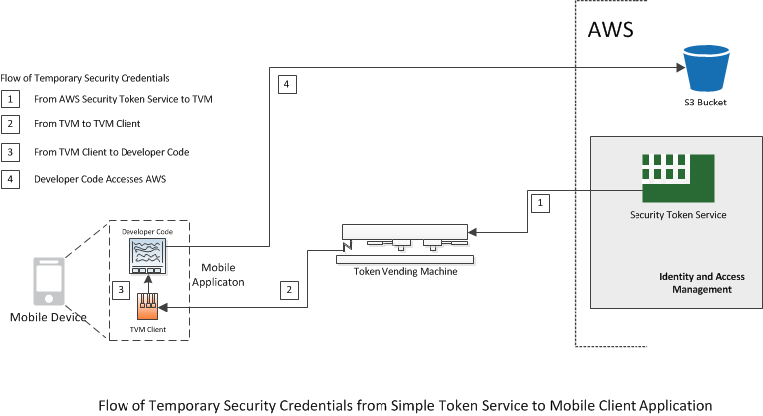
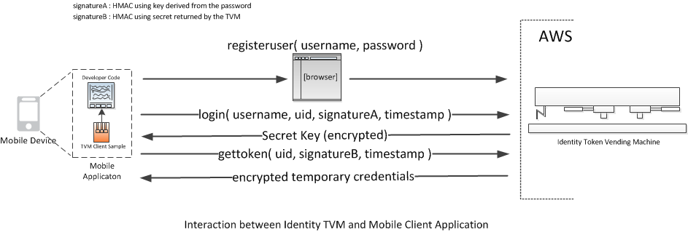
Implementation(1)
Authenticating users of AWS mobile applications with a token vending machine

Slide 7
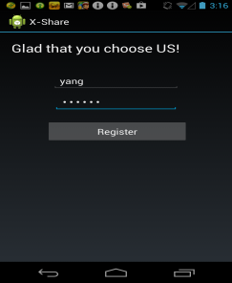
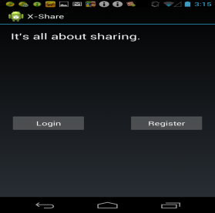
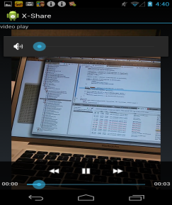
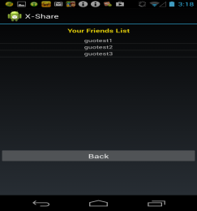
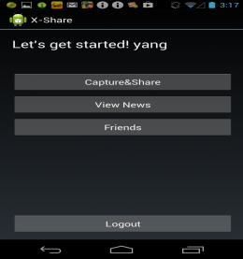
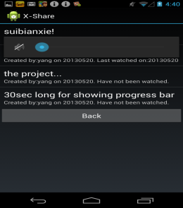
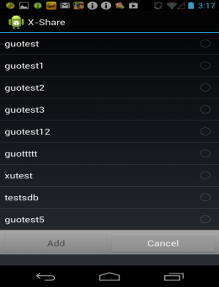
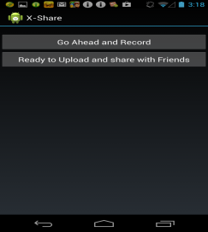
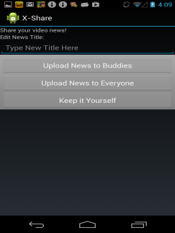
Implementation(2)
Register
Main
View News
Buddy List
Terminal
News List
Add Friend
Record News
Upload News

Slide 8
Demo
Demo 1 – Register User
Demo 2 – Broadcast Video News

Slide 9
Future Work
More functions:
E.g. “unfriend”, select existed video to share, delete uploaded video, block particular user’s sharing, use simple queue service and notification services to make contents update in real time
Optimize database function:
E.g. batch put attributes
fancier UI

Slide 10
Thank you

